Slide 1
Routing, Middleware, and Templating

Slide 2
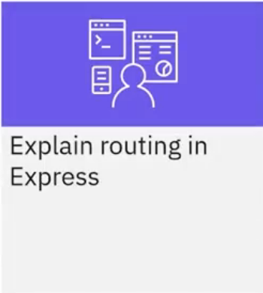
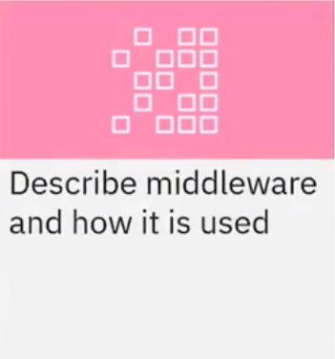
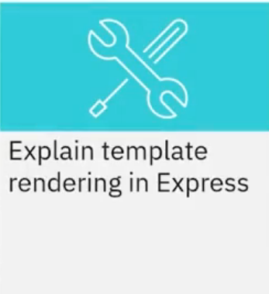
What you will learn

Slide 3
Routing
• Requests to different routes
• GET, POST, PUT, DELETE
• App level and router level

Slide 4
Middleware
• Functions that have access to the request and response
objects and the next function
• Can be chained
• Categorized based on purpose, use, and source
• Useful to parse requests, add authentication, handle errors,
and other common activities

Slide 5
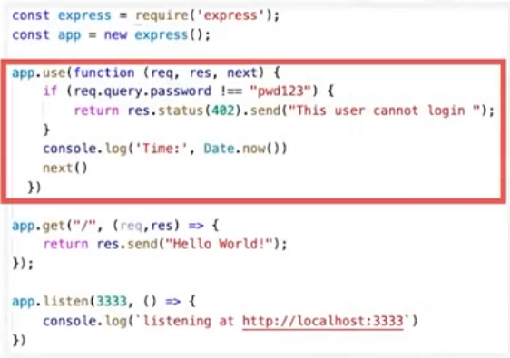
Application-level middleware
• Bound with app.use()

Slide 6
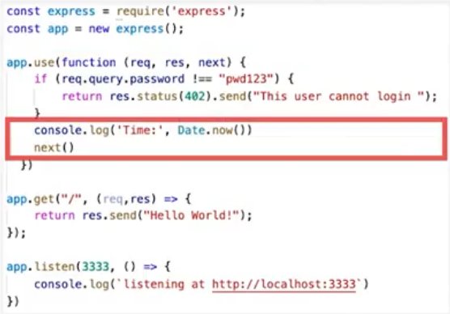
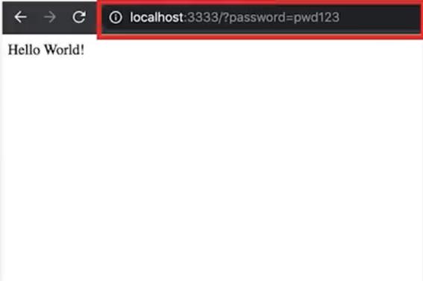
Application-level middleware
• Bound with app.use()

Slide 7
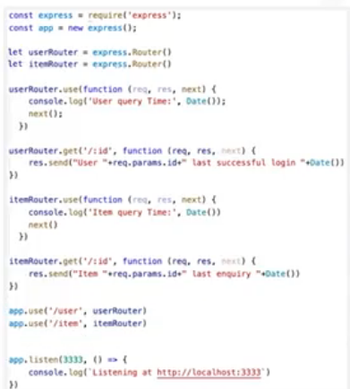
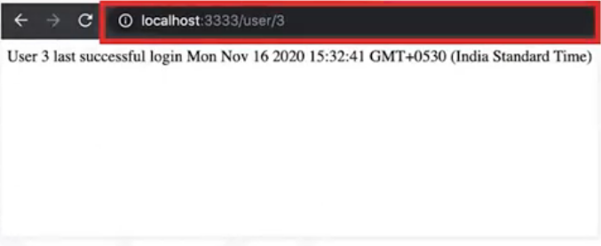
Router-level middleware
• Bound with router.use()

Slide 8
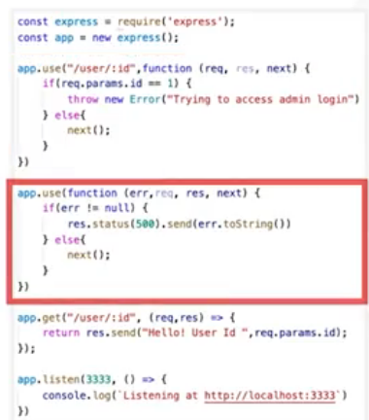
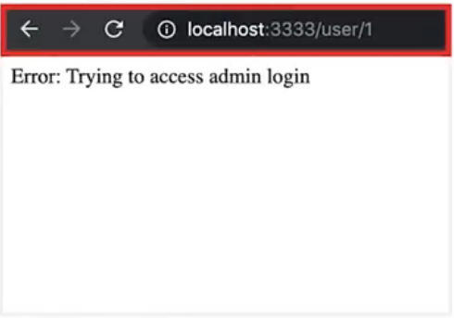
Error-handling middleware
• Bound with app.use or router.use()

Slide 9
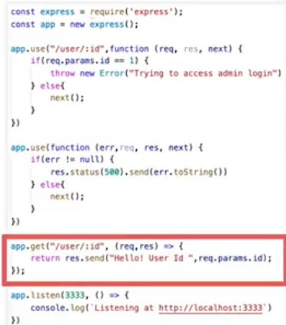
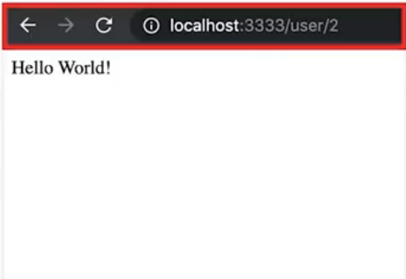
Error-handling middleware
• Bound with app.use or router.use()

Slide 10
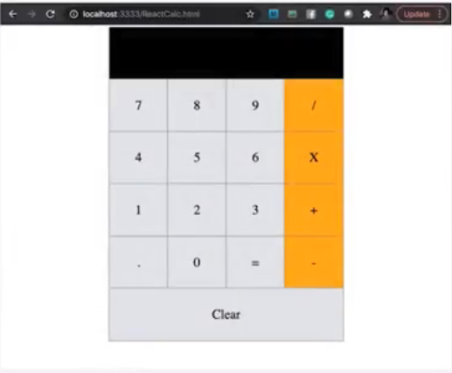
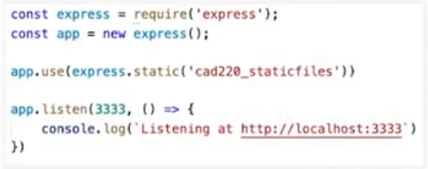
Built-in middleware
• Static files, cookie parser, JSON

Slide 11
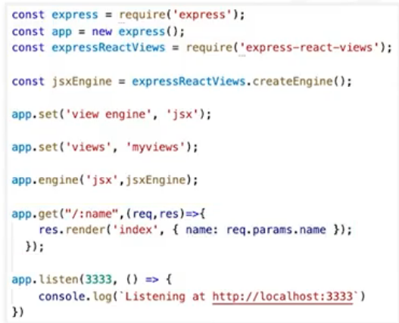
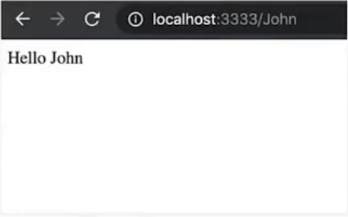
Template rendering
• Rendering dynamic content

Slide 12
Recap
In this video, you learned that:
• Routers are used for branching query handling
• Five types of middleware are application level, router level,
error handling, built-in, and third party
• Template rendering is the ability of the server to fill in dynamic
content in the HTML template

